Slide 1
Data-driven Decision Making
Emanuele Della Valle
Prof. @ Politecnico di Milano
Founder & Partner @ Quantia Consulting
Marco Balduini
Founder & CEO @ Quantia Consulting
Riccardo Tommasini
Prof. @ University of Tartu

Slide 2
Taking Decisions
In many organizations decisions are made by "questionable" methodologies

Slide 3
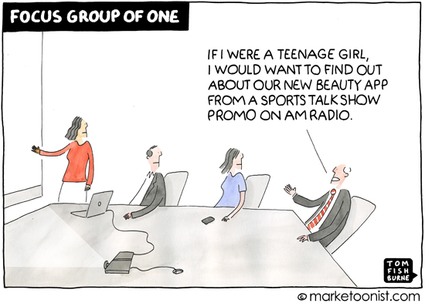
Taking Decisions: HiPPO

Slide 4

Taking Decisions: Flipism

Slide 5
Taking Decisions (cont.)
In many organizations decisions are made by "questionable" methodologies such as
Highest Paid Person Opinion (HiPPO)
Flipism (all decisions are made by flipping a coin)
This could have been the right approach in the '70s …
See the "Theory of Bounded Rationality" by Herbert Simons

Slide 6
Taking Decisions (cont.)
In many organizations decisions are made by the "questionable" methodologies such as
Highest Paid Person Opinion (HiPPO)
Flipism (all decisions are made by flipping a coin)
This could have been the right approach in the '70s …
See the "Theory of Bounded Rationality" by Herbert Simons
… but in the Digital Era one can dream of data-driven organization

Slide 7
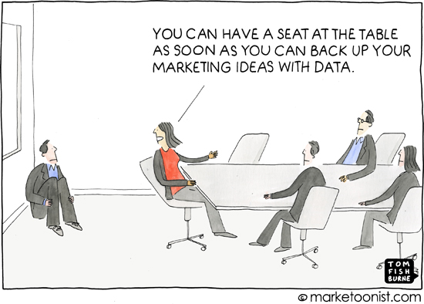
Taking Decisions: data-driven organization

Slide 8
Data-Driven Decisions
Decisions no longer have to be made in the dark or based on gut instinct; they can be based on evidence, experiments and more accurate forecasts.
-- McKinsey

Slide 9
Data-driven organizations
perform better
The data shows where they can streamline their processes
are operationally more predictable
Data insights fuel current and future decision making
are more profitable
Constant improvements and better predictions help to outsmart the competition and improve innovation.

Slide 10




It's a streaming world …
Off-shore oil operations
Smart Cities
Social networks
Generate data streams and events!
E. Della Valle

Slide 11
… looking for historical analysis …
What is the average time to failure for the different brands of turbine in use?
What is the maximum delay of the public transport per city district?
Which content features are correlated to high impact posts?
Requiring the ability to store massive timeseries and process them in a scalable way
E. Della Valle

Slide 12
… struggling with reactive answers
What is the expected time to failure when that turbine starts to vibrate as detected in the last 10 minutes?
Can I get to that meeting in the next 15 min using public transport?
Who is driving the discussion about the top 10 emerging topics?
Requiring continuous processing and reactive answers
E. Della Valle

Slide 13
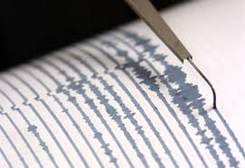
Because there are two moments to extract value from data
reactive decisions
historical analysis
Value
ms. sec. min. hours days months years
velocity

Slide 14
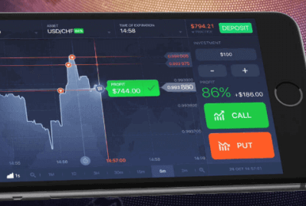
Because there are two moments to extract value from data
reactive decisions
historical analysis
Value
ms. sec. min. hours days months years
velocity

Slide 15
Because there are two moments to extract value from data
reactive decisions
historical analysis
Value
E. Della Valle
ms. sec. min. hours days months years
velocity

Slide 16
Data-driven decision
Descriptive
What happen?
Diagnostic
Why did it happen?
historical
analysis
Predictive
What will happen?
Data
Decision
Action
Decision Support
reactive decisions
Prescriptive
What should I do?
Decision Automation
[src. Gartner]
Machine-centered
Human-Centered

Slide 17
Data-driven Decision Making
Emanuele Della Valle Prof. @ Politecnico di Milano & Partner @ Quantia Consulting
Marco Balduini Founder & CEO @ Quantia Consulting
Riccardo Tommasini Prof. @ University of Tartu

